Slide 1

A project on
FAKE NEWS DETECTION USING NLP & ML
Submitted By:
Faizan Alam ( 17105129030) Megha Agarwal ( 17105129020) Sharique Zahir (17105129017)
Cse 8th sem Cse 8th sem Cse 8th sem
In partial fulfillment for the award of the degree
OF
BACHELOR OF TECHNOLOGY
IN
COMPUTER SCIENCE AND ENGINEERING
at
Under guidance of
Prof. Dr. Dharmveer kr. Yadav
CSE Department
Katihar Engineering College, Katihar

Slide 2
Contents:
    Introduction
    Why Fake news detection?
    Objective
    Libraries required
    Models used
    Output
    Future work
    conclusion

Slide 3

Fake News refers to false reports or misinformation shared in form of articles, images, or videos which disguised as “real news” and aim to manipulate people’s opinions. Fake news is spread by social media users and hidden social bots which comment on, repost and retweet such news items.
Introduction

Slide 4

Detection of fake news is important in today’s Society because in every 60 sec approx. 98000 Tweets are shared on Twitter ,600 videos are uploaded on youtube,160 millions emails are sent,1500 blog entries are created, 600,000 status update and post on facebook and whatsapp. So the fake news spread very quickly.
Why
Fake News Detection?

Slide 5
Objective: -
Aim to perform a binary classification of various news article
available online.
Use various models for finding the news is fake or not.
Graphical representation of news count and
the confusion matrix.

Slide 6

Libraries Required
Word cloud
Word cloud are visual representation of words that give prominence to words that appear more frequently.

Slide 7

2. Pandas
It is a fast, powerful, flexible and easy to use open source data analysis and manipulation tool.

Slide 8

3. Matplotlib
It is a low level graph plotting library in python that serves as a visualization utility.

Slide 9
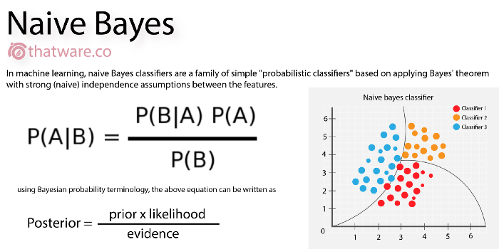
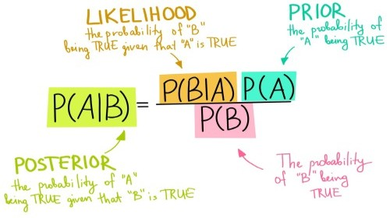
Models used
MultiNomial Naive Bayes
Multinomial Naive Bayes algorithm is a probabilistic learning method that is mostly used in Natural Language processing. This algorithm based on Bayes theorem and predict the tag of a text.

Slide 10
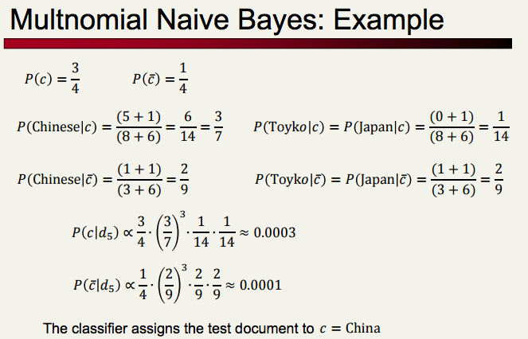

Slide 11
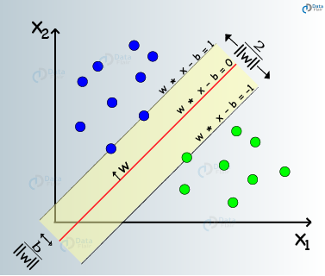
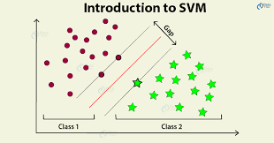
2. Support Vector Machine
It is supervised learning models that analyze data for classification and regression analysis.

Slide 12
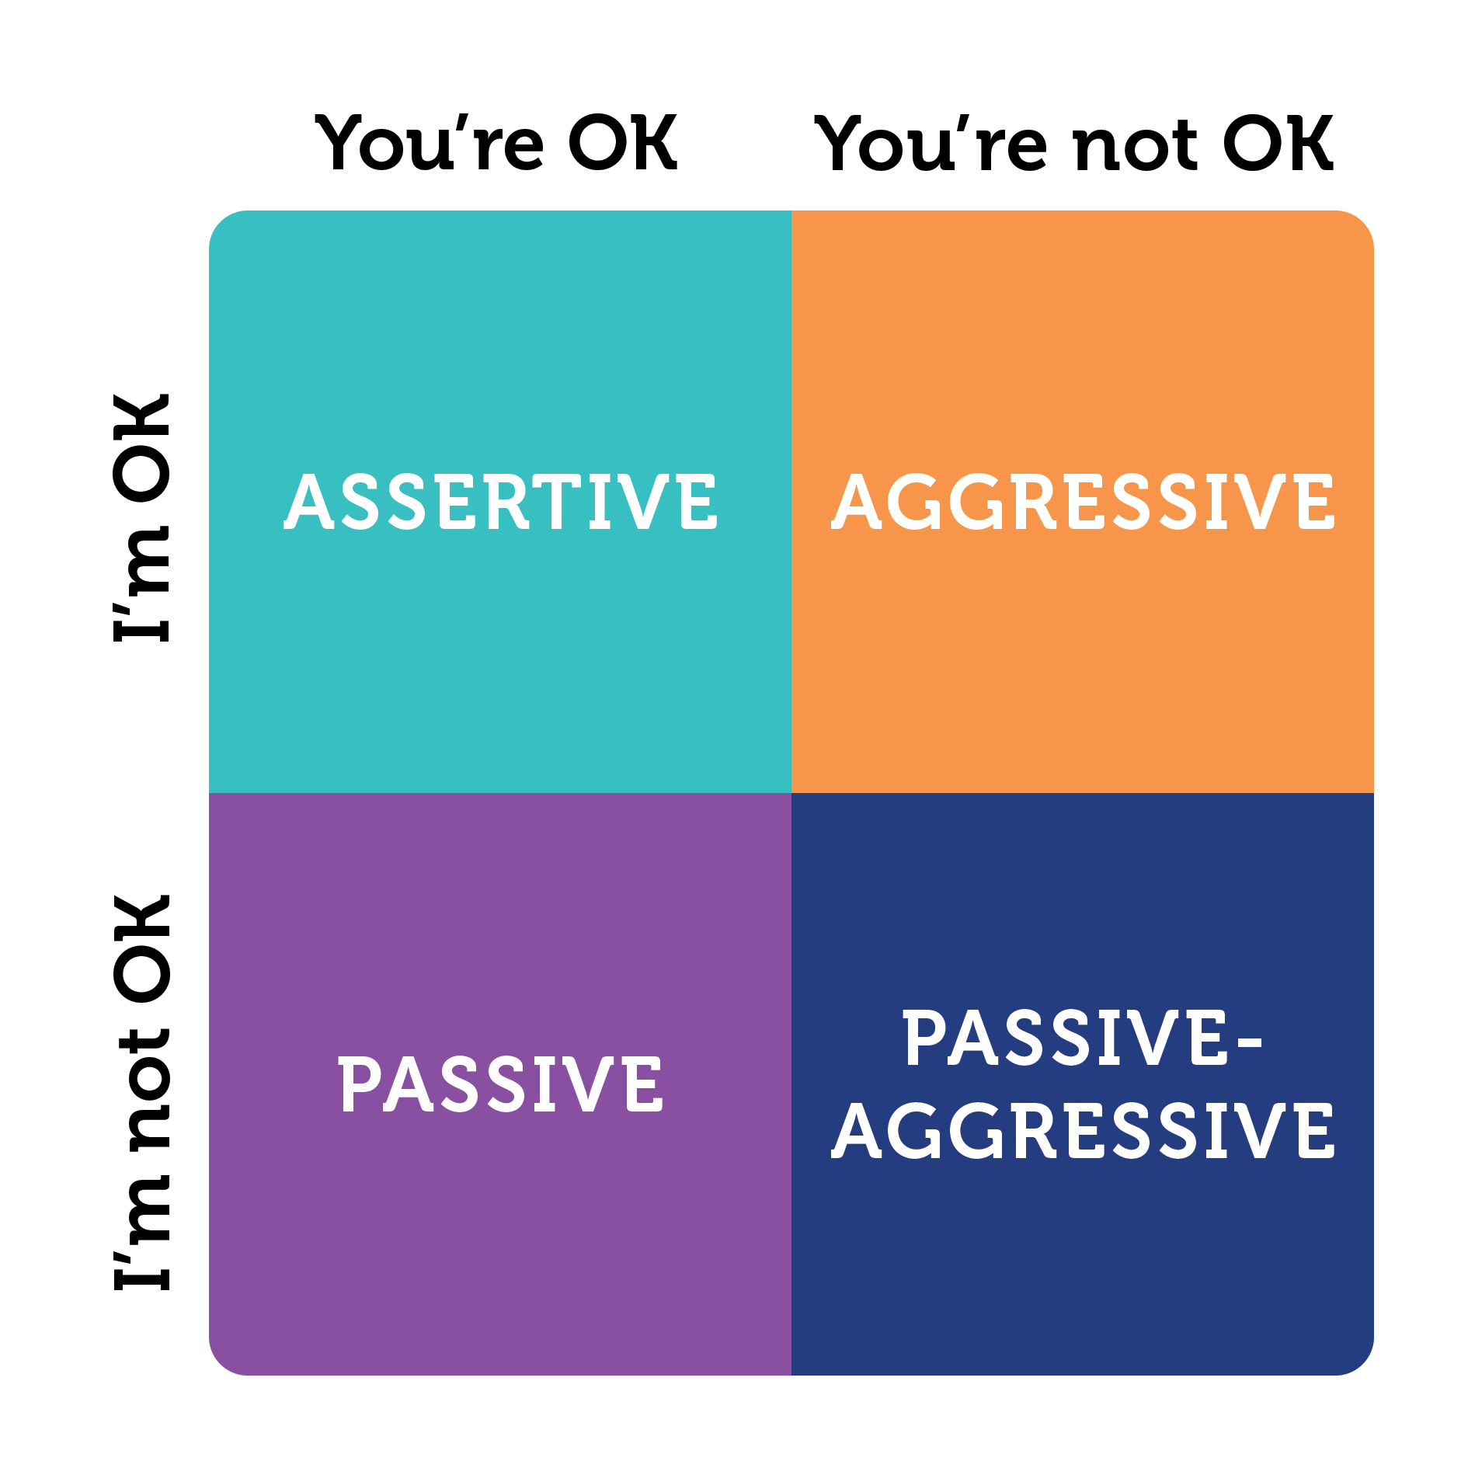
3. Passive Aggressive Models
It is an online algorithm that learns from massive streams of data. It is easy to implement.

Slide 13
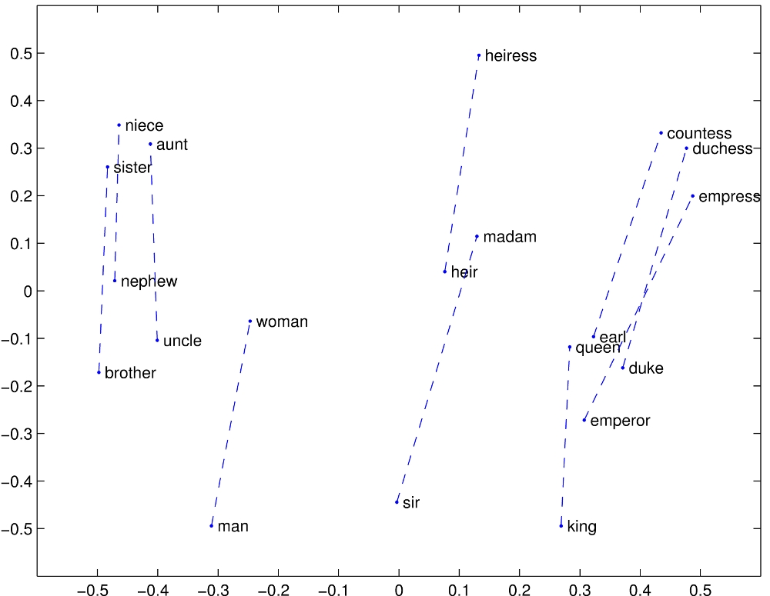
4. GloVe
It is an unsupervised learning algorithm for obtaining vector representations of words.

Slide 14
Flow chart
Input data
set
Removing Stopwords
& Data cleaning
Test & Train Dataset
using various model
Start
Calculating accuracy
&
Confusion matrix
End
Experiment Result

Slide 15
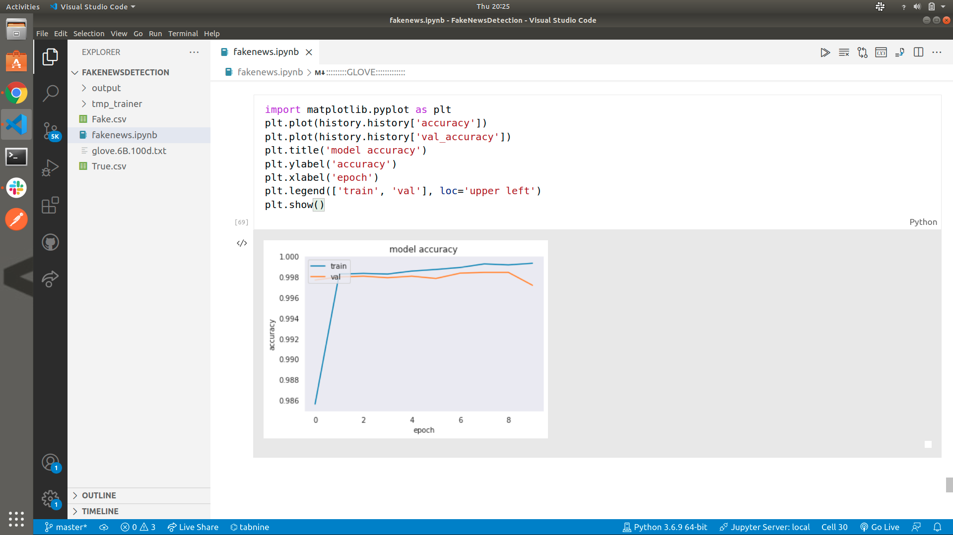
Output of Glove model accuracy vs Epoch graph

Slide 16
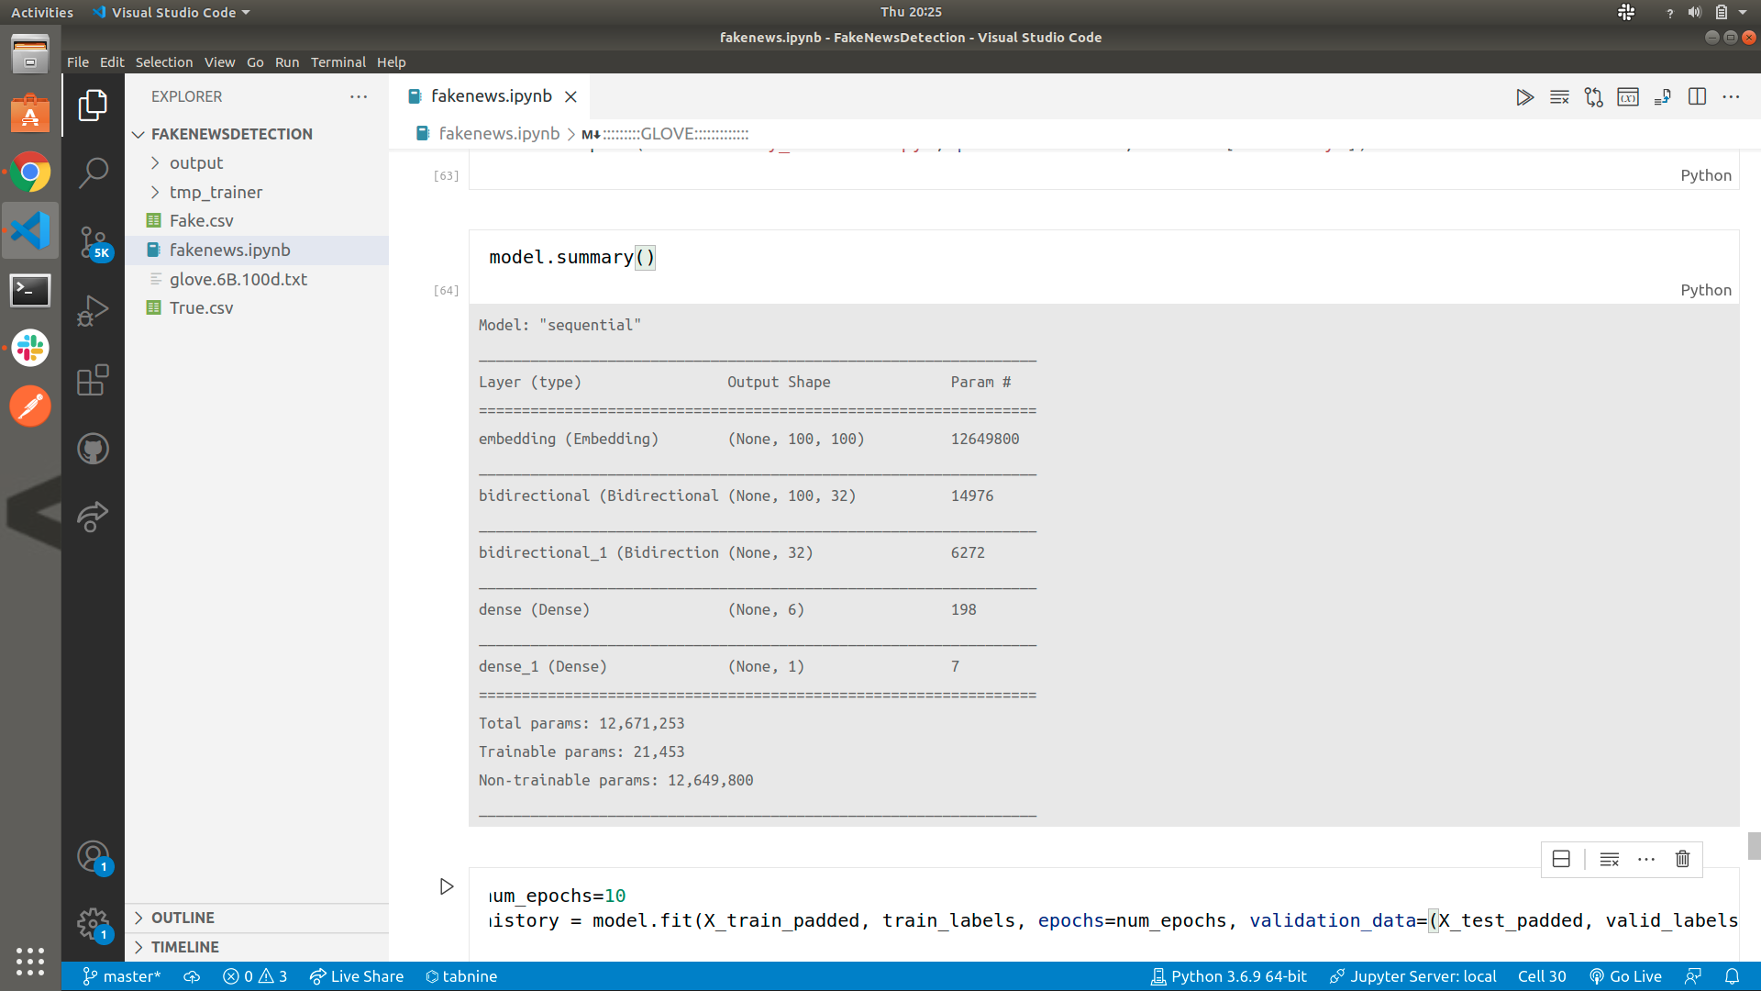
Output of Glove model summary

Slide 17
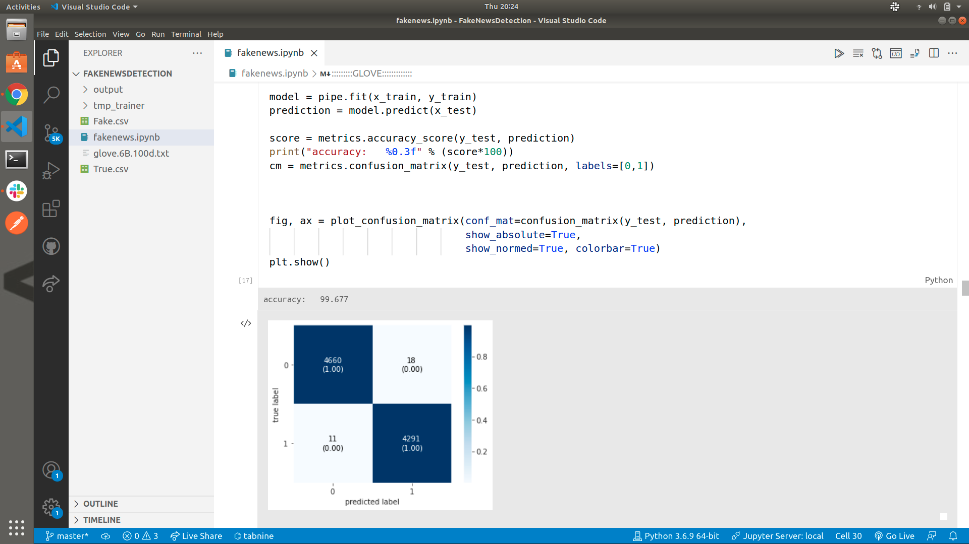
Output of confusion matrix

Slide 18
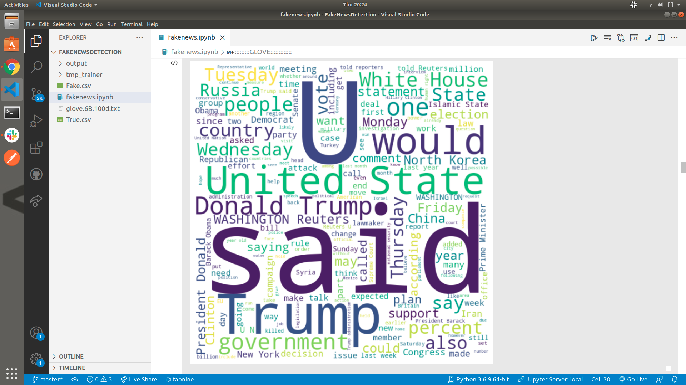
Output of WordCloud of true.csv dataset

Slide 19
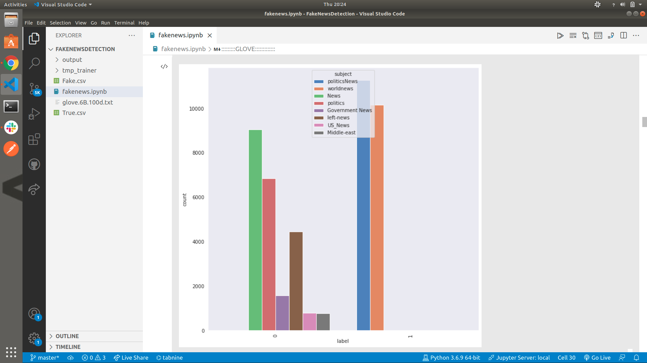
Output of subject wise news count graph

Slide 20
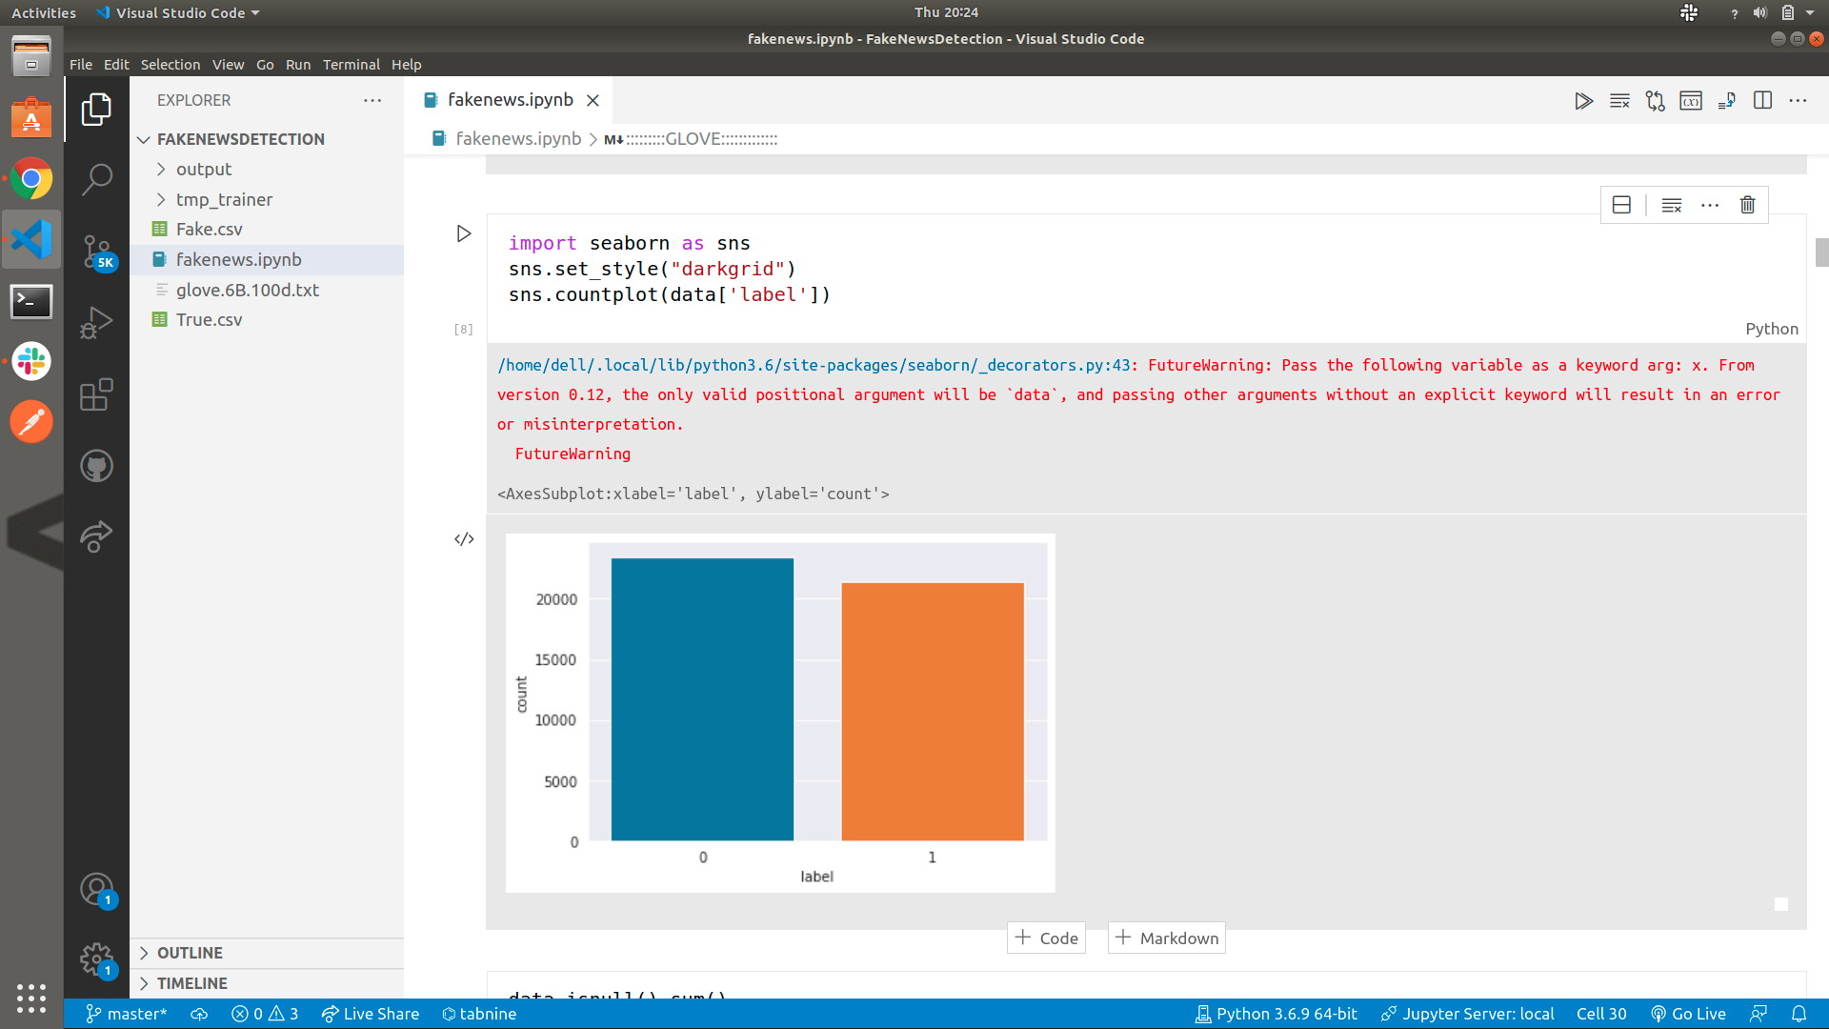
Output of Label wise graph

Slide 21

Output of GUI to show the news is fake

Slide 22

Output of GUI to show the news is true

Slide 23
Future work
We use Bert (Bidirectional Encoder Representations from Transformers) model in future for more accuracy.
We also use ELMO(Embeddings from Language Models) in future for better accuracy. ELMO is a novel way to represent words in vectors or embeddings.

Slide 24
Conclusion
The Fake News Detection is a powerful tool for identifying the fake news. We use different models like
Multinomial Naïve bayes which gives 99.677% accuracy
Support vector machine which gives 99.699% accuracy and
Passive aggressive model gives 93.909% accuracy
GloVe which gives the 99.8% accuracy .

Slide 25
Thank you

